Slide 1
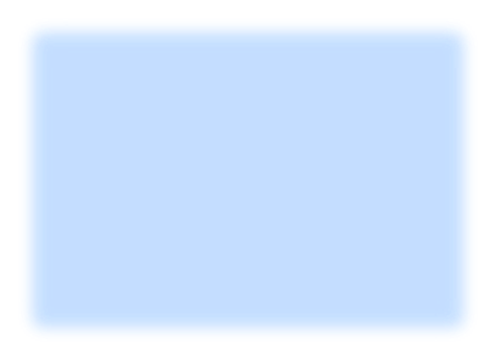
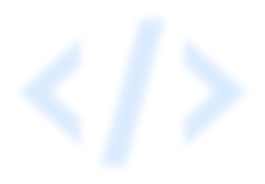

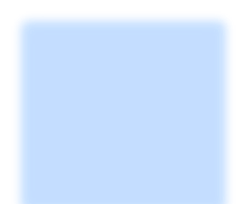

REPULSE
Weapon Detection, Tíacking and Aleíting model using Python
Utkarsh Gupta
Team - Algorithm Debuggers

Slide 2
. . .
/SHIFT
<objective>
The Objective of 'Repulse' is to automatically detect a weapon (knife, pistol, rifles) and send a alerting email while capturing the screenshot of the frame in which weapon is been detected.
It can play a crucial role in enhancing the security of public places (Airports, Railway Stations, Malls, etc) by allowing the officials to take quick action for the threat.

Slide 3
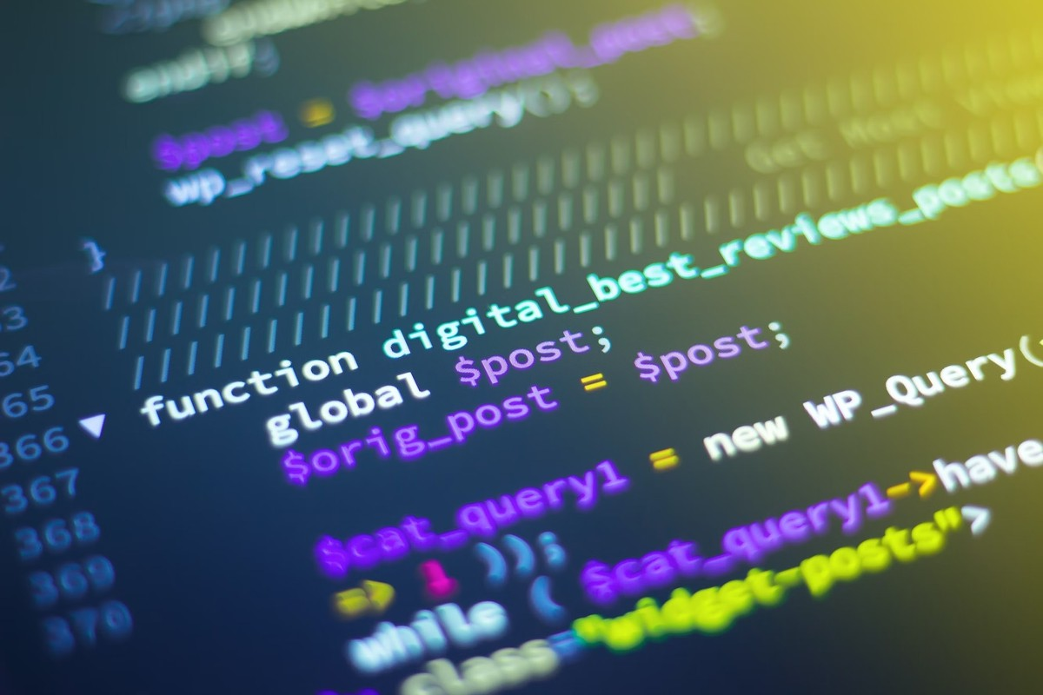
/SHIFT
. . .
<Methodology>

Slide 4


This model is been created using Python. The libraries used in it are cv2, smtplib, os and time.
YOLOv3 (You only look once) is been used used for this
model.
There are various functions created In this model for
multiple tasks like capturing the frame and detecting weapon in it, sending alert email when a weapon is been detected, capturing and storing the screenshot of the frame in which weapon is been detected.

Slide 5
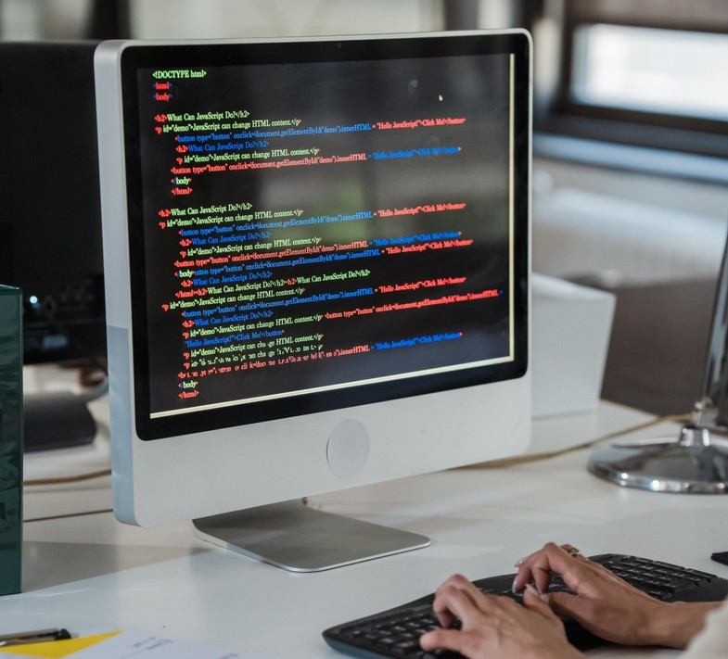
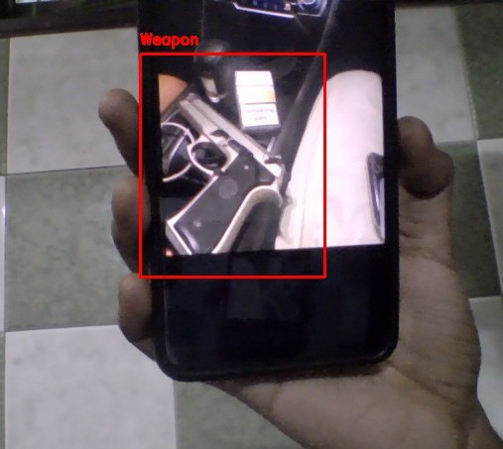
. . .
<Results>
The Model is able to detect different types of guns, knifes, rifles, Specimen of it can be seen in the image.

Slide 6
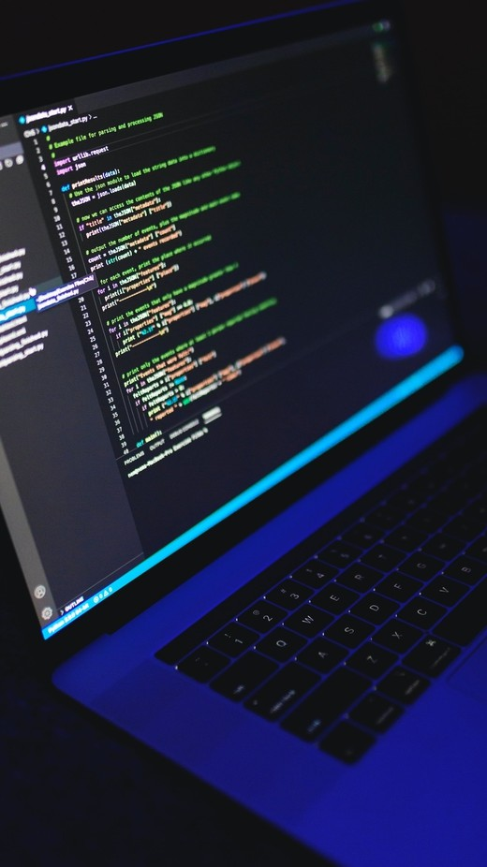
/SHIFT
<Conclusion>
The weapon detection model uses YOLOv3 to detect weapons in real-time from video streams or images. It automatically identifies dangerous items like guns and knives, marking them with bounding boxes.
When a weapon is detected, the system triggers an alert and can take a screenshot for further analysis. The model is designed to enhance security by providing fast, accurate weapon detection and
enabling quick responses in high-risk environments.

Slide 7


Thank you.

